Slide 1
Environmental Safety, Sustainability & Risk
Spill Prevention, Control, and Countermeasures (SPCC) for Farms

Slide 2

Overview
The Purpose of an SPCC is to prevent the discharge of oil into navigable waters of the United States or adjoining shorelines as opposed to response and cleanup after a spill occurs.

Slide 3
The Law
Oil Pollution Prevention Rule
Became effective January, 1974 (revised 2002).
Authority – Section 311 (j) (1) (c) of the Clean Water Act
Promulgated under Title 40, CFR, Part 112

Slide 4
Water Resources Reform and Development Act (WRRDA)
Became effective June 10, 2014.
Section 1049 of the Act changes certain applicability provisions of the SPCC rule for farms, and modifies the criteria under which a farmer may self-certify an SPCC Plan.
Under WRRDA:
A farm is not required to have an SPCC Plan if it has:
  An aggregate aboveground storage capacity less than 2,500 gallons OR
  An aggregate aboveground storage capacity greater than 2,500 gallons and less than 6,000* gallons; and
  No reportable discharge history.
  A farmer can self-certify the SPCC Plan if the farm has:
  An aggregate aboveground storage capacity greater than 6,000* gallons but less than 20,000 gallons;
  No individual tank with a capacity greater than 10,000 gallons; and
  No reportable discharge history.
  *This 6,000-gallon threshold may be adjusted by EPA, following a study to determine the appropriate exemption.

Slide 5
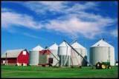
Definition of a Farm
The definition of a farm was promulgated in the December 2006 rule amendments because, at the time, EPA delayed the compliance date for farms until additional amendments to the rule were promulgated.
Additional amendments were promulgated in 2008 and farms now have the same compliance dates as other facilities.
Farm - A facility on a tract of land devoted to the production of crops or raising of animals, including fish, which produced and sold, or normally would have produced and sold, $1,000 or more of agricultural products during a year.
Notes:
Supplemental information:
PREAMBLE LANGUAGE
EPA recognizes that a farm: may be privately owned and may contain the residence of the owner or operator; has a configuration that varies across the country, from farm to farm and season to season; contains low-volume oil storage that is often dispersed across different land parcels separated by roads and natural barriers; has multiple fueling sites; is located in a remote area; stores oil on-site for on-farm use and not for further distribution in commerce; uses oil seasonally in different quantities; and leases a significant amount of land to or from secondary parties. For these reasons, EPA is proposing additional amendments to the SPCC rule that further benefit farms.

Slide 6
Oil Definitions
Oil means oil of any kind or in any form, including, but not limited to:
  fats, oils, or greases of animal, fish, or marine mammal origin
  vegetable oils, including oils from seeds, nuts, fruits, or kernels;
  other oils and greases, including petroleum, fuel oil, sludge, synthetic oils, mineral oils, oil refuse, or oil mixed with wastes other than dredged spoil.

Slide 7
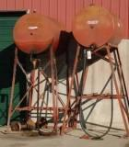
Examples of Oil on a Farm
Gasoline
Off-road and on-road diesel fuel
Hydraulic oil
Lubrication oil
Crop oil
Vegetable oils from crops
Adjuvant oil
Milk*
* Milk and Milk product containers are now exempt from the SPCC capacity calculations and rule requirements
Notes:
Supplemental information:
Milk spills must be immediately reported to the National Response Center (NRC) at 800-424-8802 or 1-202-426-2675. Because milk contains oil, the owner or operator of milk facility may be liable to clean up a spill and/or pay penalties issued under the authority of the Federal Water Pollution Control Act (Clean Water Act)

Slide 8
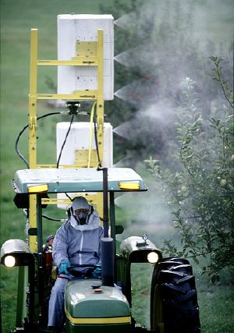
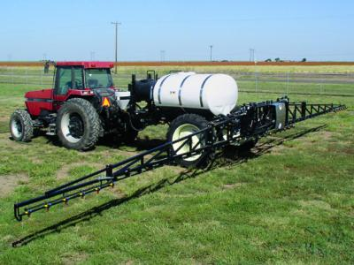
Pesticide Application Equipment
Exempt equipment includes:
  Ground boom applicators
  Airblast sprayers
  Specialty aircraft that apply measured amounts of pesticides to crops and/or soil
  Related mix containers
Exemption applies to all pesticide application equipment and related mix containers, regardless of ownership or where used
Notes:
Supplemental information:
Exempt pesticide application equipment and related mix containers from general applicability and capacity calculation.
This equipment includes:
ground boom applicators
airblast sprayers,
specialty aircraft that are used to apply measured quantities of pesticides to crops and/or soil

Slide 9
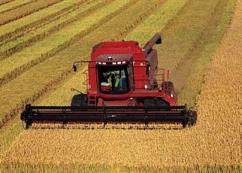
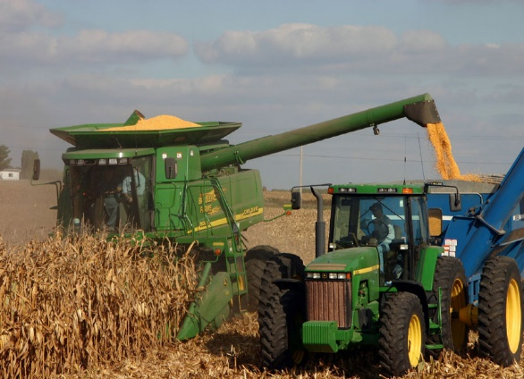
Motive Power Containers Exemption
Defined as any onboard storage containers used primarily to power the movement of a motor vehicle
Includes self-propelled agricultural, construction, and excavation vehicles; and self-propelled cranes
Oil transfer activities occurring within an SPCC-regulated facility continue to be regulated

Slide 10
Milk and Milk Product Container Exemption
All milk and milk product containers, associated piping and appurtenances are exempt from the SPCC rule
  Excluded from facility oil storage capacity calculation when determining SPCC applicability
  Exemption also includes all milk handling and transfer activities
  Milk product examples include cheese, yogurt and ice cream
Does not impact the potential liability of milk spills
  Immediately report milk and other oil spills to navigable waters or adjoining shorelines to the National Response Center (NRC) at 800-424-8802 or
  202-426-2675
Notes:
Supplemental Information:
Because milk contains oil, the owner or operator of a milk facility may be liable to clean up a spill and/or pay penalties issued under the authority of the Federal Water Pollution Control Act

Slide 11
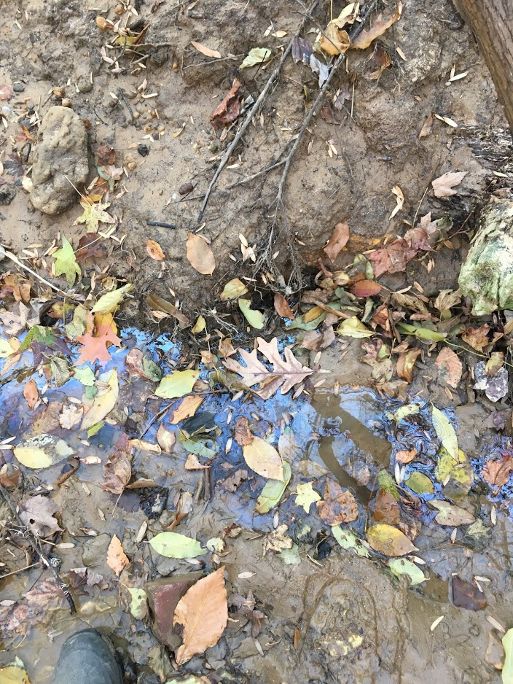
National Response Center (NRC)
The Discharge of Oil regulation provides the framework for determining whether an oil discharge to inland and coastal waters or adjoining shorelines should be reported to the National Response Center at 1-800-424-8802
Any person in charge of a vessel, onshore or offshore facility must notify NRC once there is knowledge of a discharge
NRC will relay discharge information to EPA or USCG
Notes:
Who is subject to the Discharge of Oil regulation? Any person in charge of a vessel or of an onshore or offshore facility is subject to the reporting requirements of the Discharge of Oil regulation if it discharges a harmful quantity of oil to U.S. navigable waters, adjoining shorelines, or the contiguous zone, or in connection with activities under the Outer Continental Shelf Lands Act or Deepwater Port Act of 1974, or which may affect natural resources under exclusive U.S. authority.

Slide 12
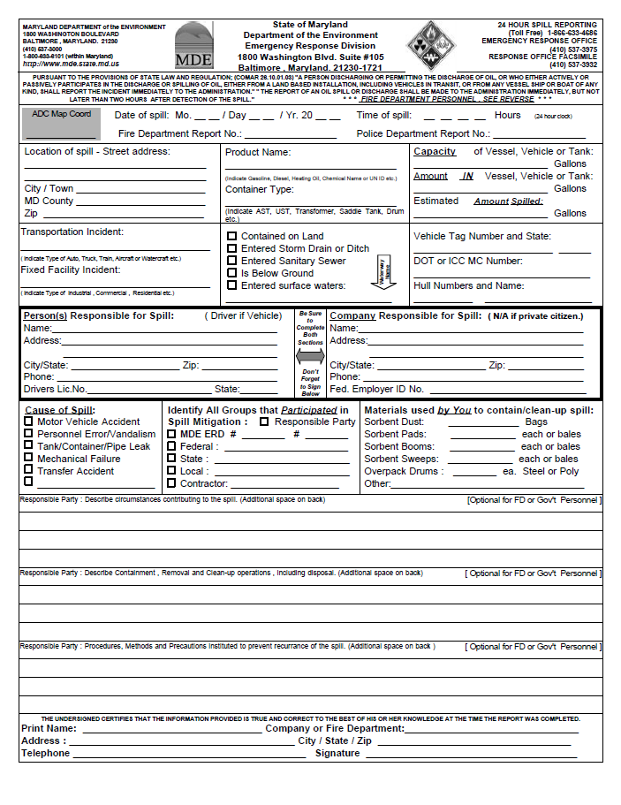
MDE Reporting Requirements
Report to MDE Emergency Response Division (1-866-633-4686) if an oil spill or discharge of ANY quantity occurs
  Within two hours after the detection of a spill
Verbal report must include:
  Time and location of discharge
  Type of facility involved
  Type and quantity of oil spilled
  Assistance required
  Name, address, telephone number of person making report
  Other pertinent info as requested by MDE
Within ten working days after completion of spill cleanup, a written report of the discharge must be submitted to MDE
Notes:
-MDE spill form found online and within our SPCC

Slide 13
Secondary Containment
All areas and equipment with the potential for a discharge are subject to general secondary containment provision, 112.7(c).
  Oil-filled operational equipment
  Loading/unloading areas
  Piping
  Mobile refuelers/ non-transportation related tank trucks
Purpose is to contain or divert to prevent discharge: dikes, berms, retaining walls, curbing, drip pans, sumps, culverting, gutters, weirs, booms, spill diversion ponds, retention ponds, sorbent
Notes:
Weirs: dam-like structure with a notch through which oil may flow to be collected

Slide 14
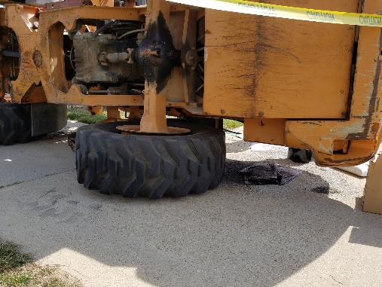
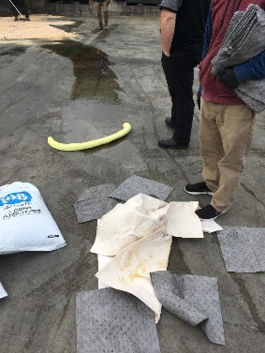
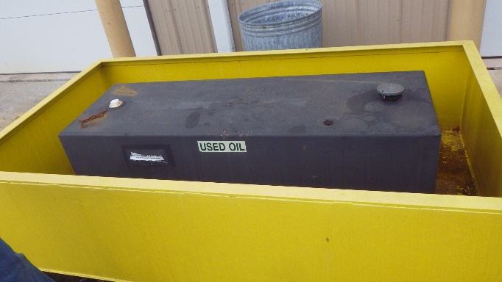
Secondary Containment
Active secondary containment is when an employee personally contains a spill,
  Deploying drain covers before a spill happens.
  Deploying drain covers after a spill has occurred, but before the spill reaches a drain
  Using a spill kit in the event of an oil discharge
  Closing a gate valve prior to a discharge
  Passive secondary containment does not require deployment or the action of an employee or employees to contain a spill.
  Placing containment pallets or decks under drums and other containers
  Surrounding machines and containers with berms
  Erecting retaining walls around machines and containers
  Placing drip trays under leaky machines and containers

Slide 15
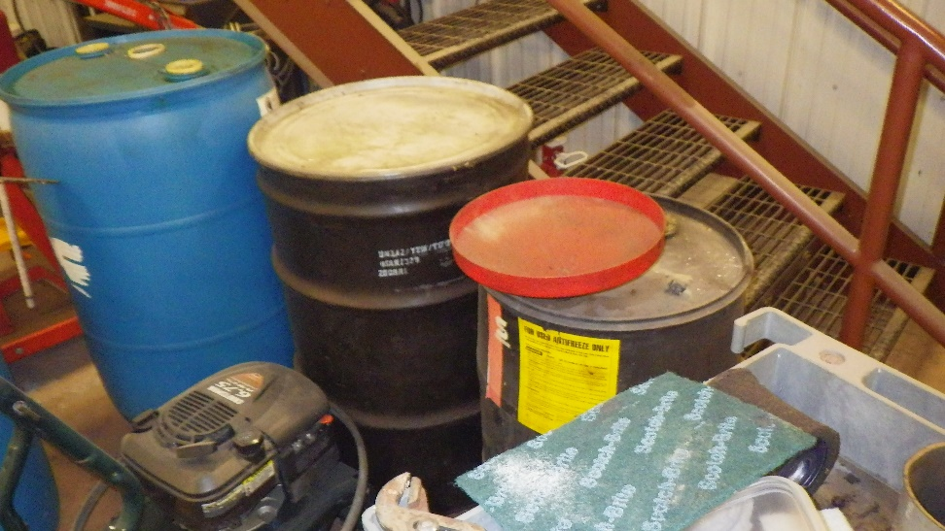
Portable Containers
Drums placed on spill pallets
Emergency generators; utilize drip pans
Fuel trucks parked within bermed area

Slide 16
Loading/Unloading Area Containment
  Dikes, berms, or retaining walls sufficiently impervious to contain oil;
  Curbing or drip pans;
  Sumps and collection systems;
  Culverting, gutters, or other drainage systems;
  Weirs, booms, or other barriers;
  Spill diversion ponds;
  Retention ponds; or
  Sorbent materials.

Slide 17
Oil – Filled Operational Equipment
Equipment that includes an oil storage container (or multiple containers) in which the oil is present solely to support the function of the apparatus or the device.
  Does not include oil-filled manufacturing equipment (flow-through process)
Piping is considered a component if it is solely used to facilitate operation of the equipment device.
Examples: hydraulic systems, lubricating systems, gear boxes, machining coolant systems, heat transfer systems, transformers,
circuit breakers, electrical switches, other systems containing oil solely to enable the operation of the device
Notes:
-oil-filled manufacturing equipment typically involves a flow-through process, commonly interconnected with piping
-if piping is not intrinsic to the equipment such as flowlines, transfer piping, then it is not a component of oil-filled operational equipment

Slide 18
Inspection & Testing 112.8(c)(6)
Prevent discharge of oil caused by leaks, corrosion, brittle fracture, overfill, other forms of container/equipment failure
AST are tested or inspected in accordance with industry standards
  Integrity tests include: visual inspection, hydrostatic testing, radiographic testing, ultrasonic testing, acoustic emissions testing, or other systems of non-destructive testing.
Notes:
-keep records, inspect containers supports and foundations

Slide 19
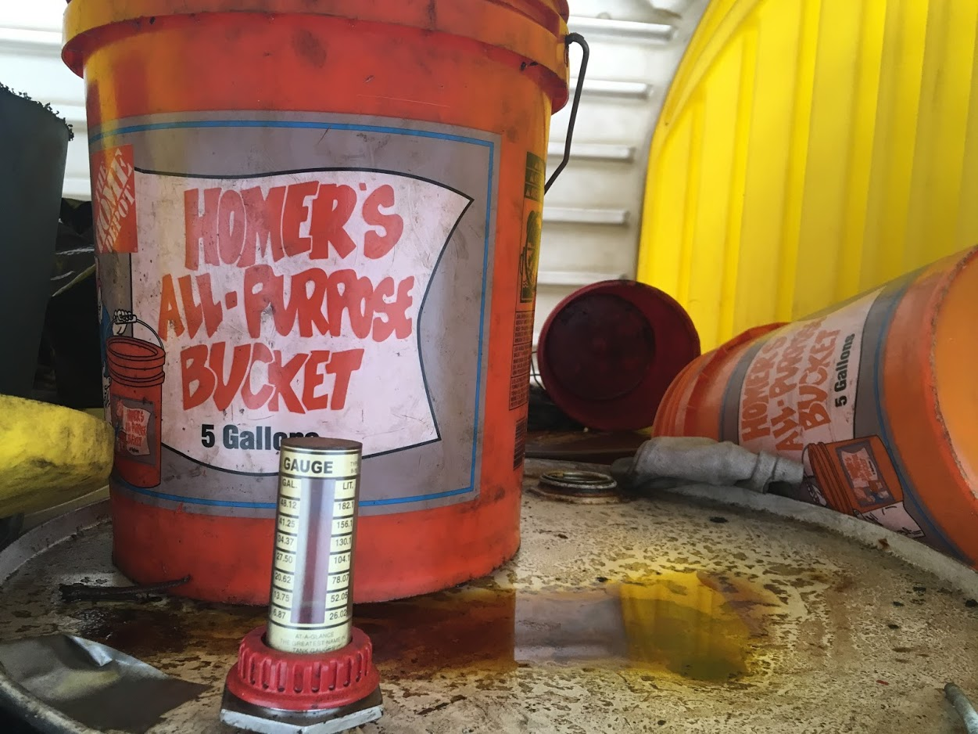
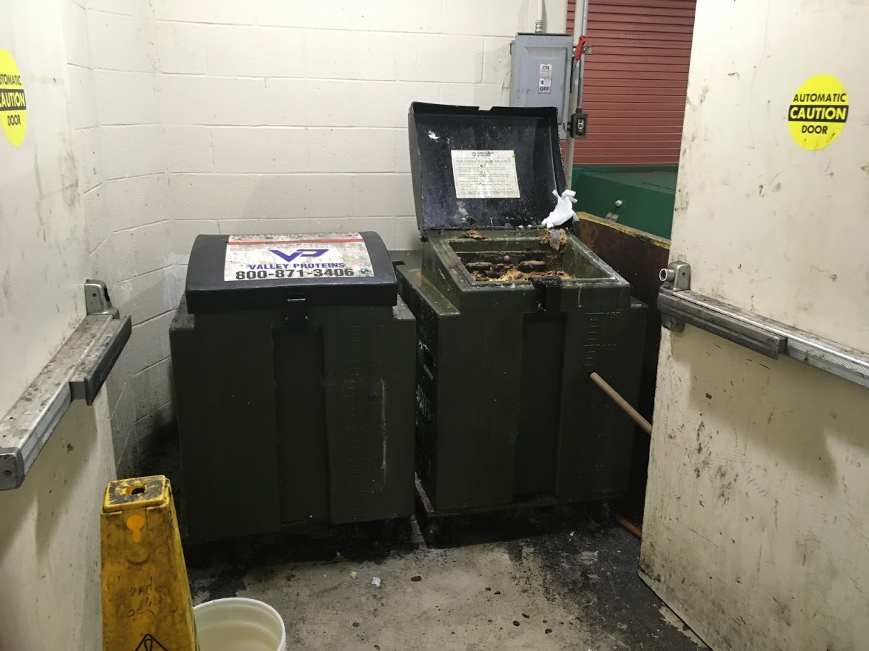
Visual inspection:
Poor housekeeping: Spillage, unlabeled contained with grease in it
Spillage

Slide 20
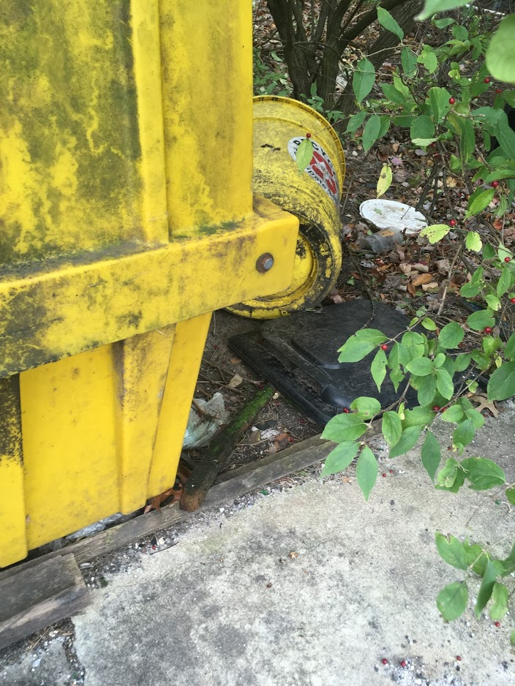
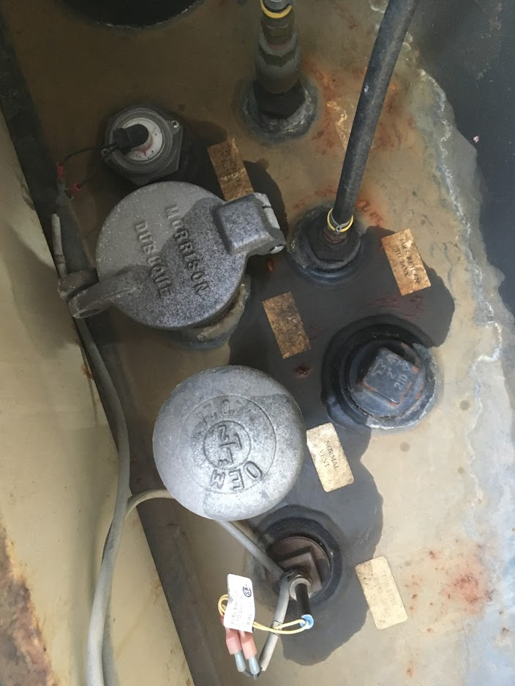
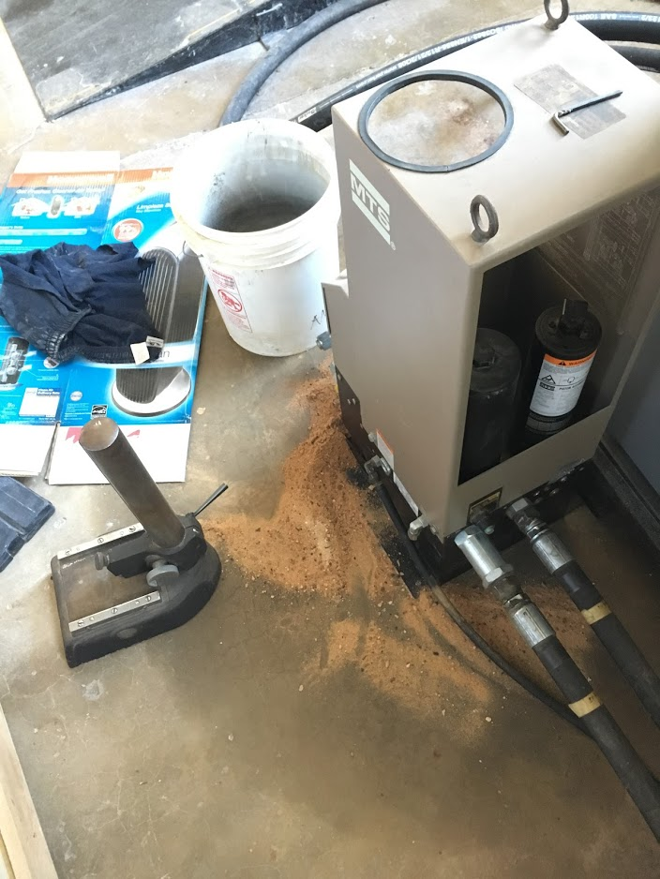
Visual Inspection:

Slide 21
Remember!
All actions (visual inspection or testing) must be documented & maintained
  Some standards require records to be maintained for over 3 years for comparison reasons
Know objective: the tank IS or IS NOT suitable for continued use
Notes:
API Standard 653: tank inspection, repair, alteration, reconstruction minimum requirements for maintaining the integrity of carbon and alloy steel tanks built to API standard 650 and its predecessor API 12C, also any steel tank constructed to a tank specification

Slide 22
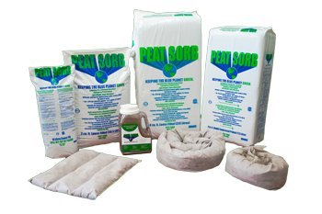
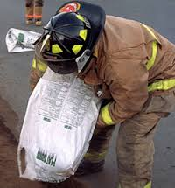
Oil Containment: Examples
A lightweight non-biodegradable absorbent made from 100% Canadian Sphagnum Peat Moss
Absorbed oil passes the Toxicity Characteristic Leaching Procedure (TCLP)
Affinity for hydrocarbons of all types
Suppresses 90% of gasoline vapors which eliminates the danger of explosion
Notes:
-disposed of through incineration or placed in landfills
-bags, pillows, socks, spill kits, spill kit replacement components, drums, containers, supplier specific products
-pic: http://peatsorb.ca/index.php?id=22

Slide 23
SPCC Plan Requirements
Each Plan Must Include:
Description of physical layout and a facility diagram.
Key personnel contact list and phone numbers for the facility response coordinator, cleanup contractors, all appropriate federal, state, local agencies to contact.
Prediction of direction, rate of flow, and total quantity of oil that COULD be discharged if the potential for equipment discharge exists.
Description of containment and/or diversionary structures to prevent discharge from reaching navigable waters.
Description of site specific spill prevention and control measures in place.

Slide 24
SPCC Training Requirements
Train oil-handling personnel:
  Operation/maintenance of prevention equipment
  Discharge procedure protocols
  Applicable pollution control laws, rules, and regulations
  General facility operations
  Contents of the facility SPCC Plan
Designate person accountable for discharge prevention and who reports to facility management
Schedule/conduct at least one training a year:
  Known discharges and failures, malfunctioning components, new precautionary measures
Notes:
24
Supplemental information:
This does not have to be a complex classroom type event, but it must occur. If you can get it done on the back of a pickup or in a barn or house, and cover the necessary items, and document it, it will suffice.

Slide 25
Additional Requirements
Plan must have MANAGEMENT APPROVAL (signature)
Plan must be maintained on-site AVAILABLE AT ALL TIMES for review by EPA/MDE.
Plan must include periodic INSPECTIONS.
Plan must be revised/updated to reflect facility changes.
Plan required to be reviewed/revised at least every 5 YEARS.

Slide 26
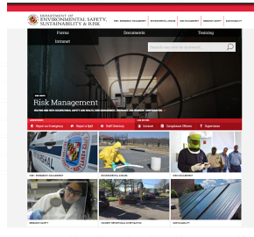
How to Reach Us
www.essr.umd.edu
Call 301-405-3960 during business hours
Call UMPD Communications at 301-405-3555 to reach on-call ESSR staff after business hours.
Email safety@umd.edu

